Slide 1

Amplitude Modulation and Demodulation Using Analog
Multipliers
Team: Athul, Arpit, and Rohith | Group No: 1 2

Slide 2
Aim and Objective
To create a modulation and demodulation circuit using analog multipliers
Analyze advantages over the standard envelope detector
Understand advantages over standard diode-based circuits and its utility

Slide 3
Working Principle
THE WORKING OF DEMODULATION :
The circuit receives an AM(Amplitude Modulated) signal and multiplies it with a locally generated carrier signal of the same frequency and phase ,i.e. a coherent signal which is then passed through a low pass filter to obtain back the message signal [m(t)].
01
02
Input
Receive amplitude modulated signal: s(t) = [1 + m(t)] cos(ω_{c}t) where, m(t)=Message signal and ω_{c}=Carrier signal frequency
Local Carrier
Generate coherent carrier: V_{LC} = cos(ωₒt)
With the help of the analog multipliers, we obtain the product of the two signals.

Slide 4
The multiplication produces both baseband and high-frequency components:
Then the multiplied signal becomes:
Using trigonometric identity: cos𝐴⋅cos𝐵=1/2[cos(𝐴−𝐵)+cos(𝐴+𝐵)]
Low Frequency Term
High Frequency Term
½[1 + m(t)] - Baseband message signal
½[1 + m(t)] cos(2ωct)
On passing this product signal through a low pass filter we can recover the
Message signal: ½[1+m(t)]

Slide 5
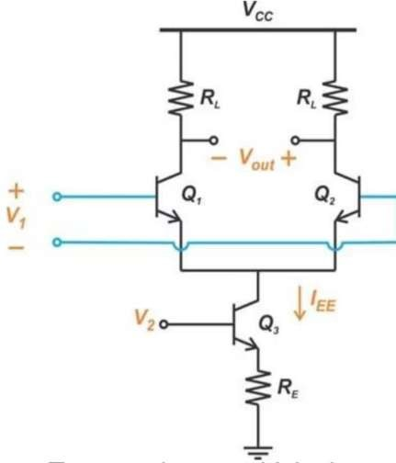
Implementation Using Analog Multiplier
For getting the product signal we use the help of analog multipliers.
There are many ways to construct such multipliers, we can use specific IC’s (AD633) or we can build discrete circuits like the Gilbert cell.
Now we’ll take a look at the implementation of a simplified version of a gilbert cell which is essentially a variable transconductance multiplier.

Slide 6
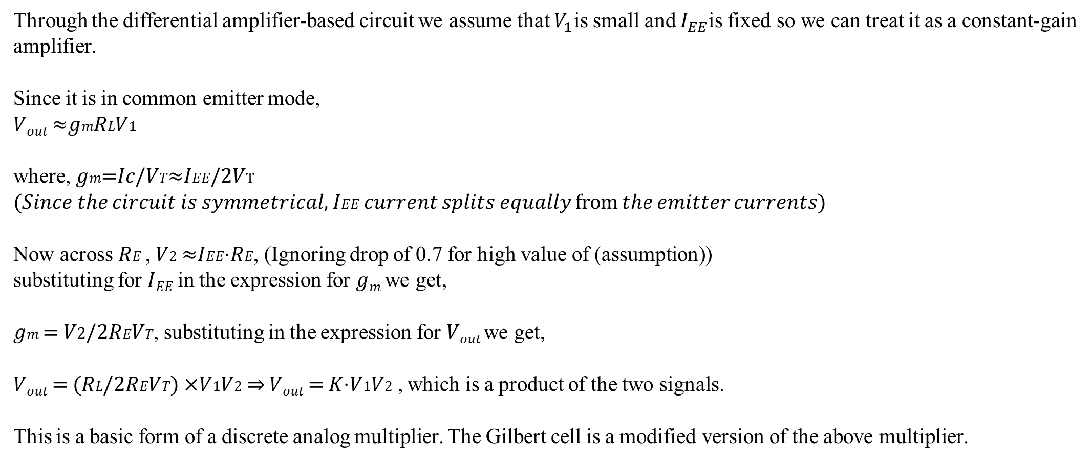
Through the differential amplifier-based circuit we assume that $V_{1}$is small and $I_{EE}$is fixed so we can treat it as a constant-gain amplifier.
Since it is in common emitter mode,
𝑉_{𝑜𝑢𝑡} ≈𝑔𝑚𝑅𝐿𝑉1
where, 𝑔𝑚=𝐼𝑐/𝑉𝑇≈𝐼𝐸𝐸/2𝑉T
(𝑆𝑖𝑛𝑐𝑒 𝑡ℎ𝑒 𝑐𝑖𝑟𝑐𝑢𝑖𝑡 𝑖𝑠 𝑠𝑦𝑚𝑚𝑒𝑡𝑟𝑖𝑐𝑎𝑙, 𝐼𝐸𝐸 𝑐𝑢𝑟𝑟𝑒𝑛𝑡 𝑠𝑝𝑙𝑖𝑡𝑠 𝑒𝑞𝑢𝑎𝑙𝑙𝑦 from 𝑡ℎ𝑒 𝑒𝑚𝑖𝑡𝑡𝑒𝑟 𝑐𝑢𝑟𝑟𝑒𝑛𝑡𝑠)
Now across 𝑅𝐸 , 𝑉2 ≈𝐼𝐸𝐸⋅𝑅𝐸, (Ignoring drop of 0.7 for high value of (assumption)) substituting for 𝐼_{𝐸𝐸} in the expression for 𝑔_{𝑚} we get,
𝑔𝑚 = 𝑉2/2𝑅𝐸𝑉𝑇, substituting in the expression for 𝑉_{𝑜𝑢𝑡} we get,
𝑉_{𝑜𝑢𝑡} = (𝑅𝐿/2𝑅𝐸𝑉𝑇) ×𝑉1𝑉2 ⇒ 𝑉_{𝑜𝑢𝑡} = 𝐾⋅𝑉1𝑉2 , which is a product of the two signals.
This is a basic form of a discrete analog multiplier. The Gilbert cell is a modified version of the above multiplier.

Slide 7
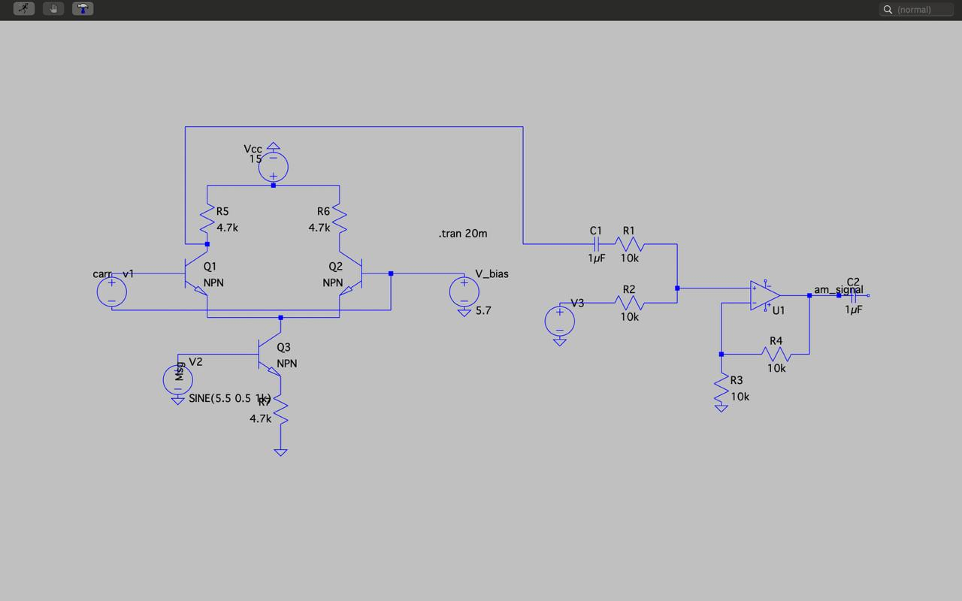
Amplitude Modulation Circuit
The modulation circuit generates AM waves by multiplying signals and adding a local carrier using a non-inverting op-amp adder circuit.

Slide 8
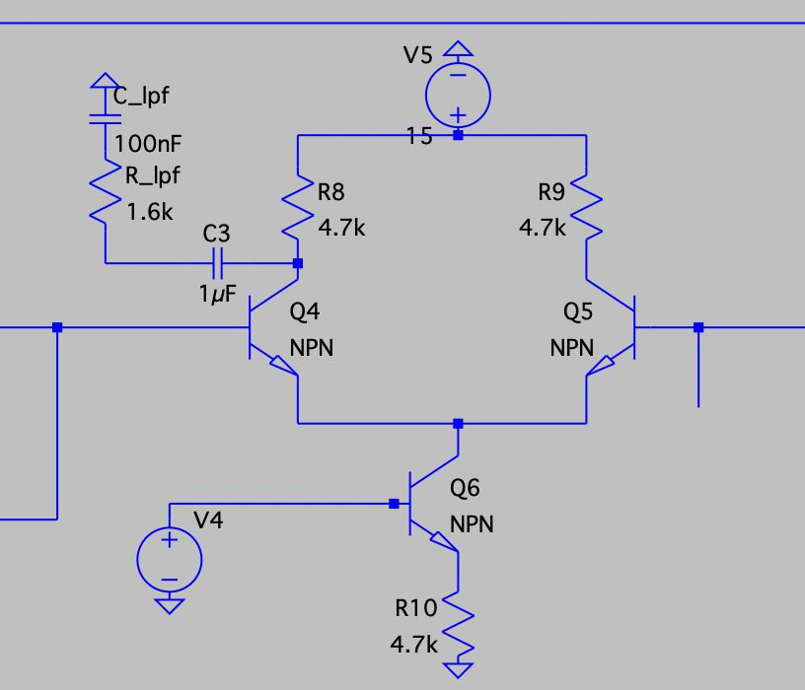
AM Demodulation
The demodulation circuit is of relatively simple task where,
Input
Receive amplitude modulated(AM) signal
Multiplier
Product with local carrier signal using a multiplier
Low Pass Filter
Passed through a simple low pass filter which removes the high frequency component
Message Signal
Generates the messenger signal
Demodulation Circuit

Slide 9
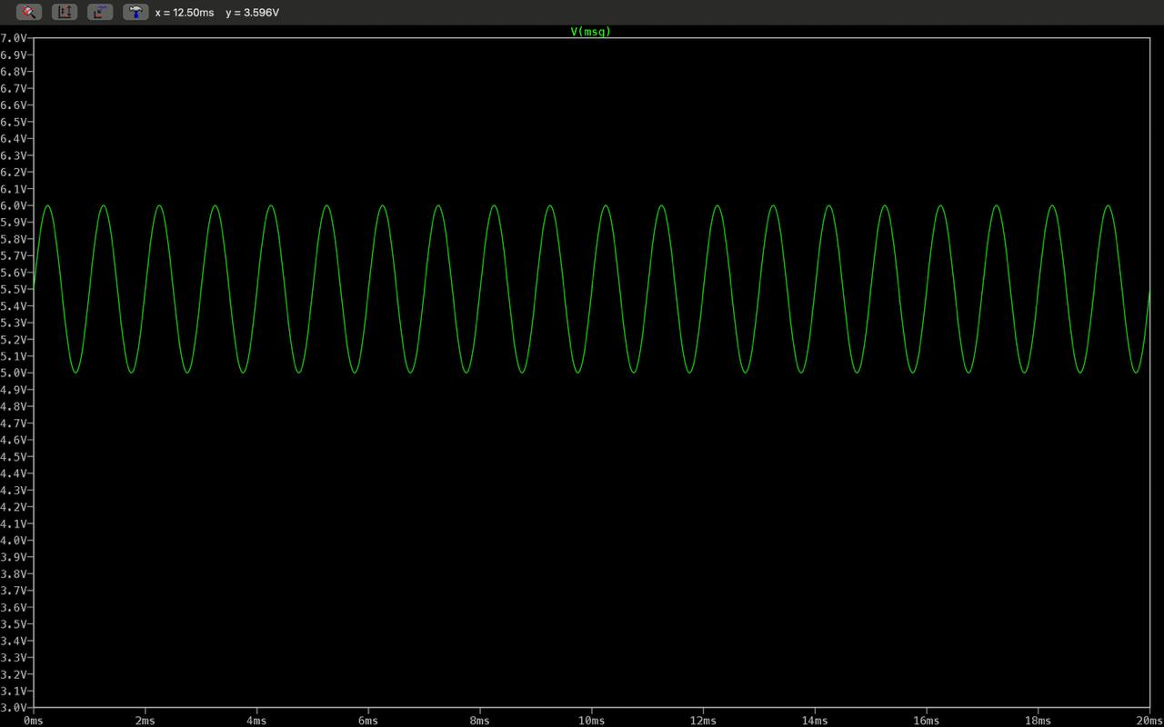
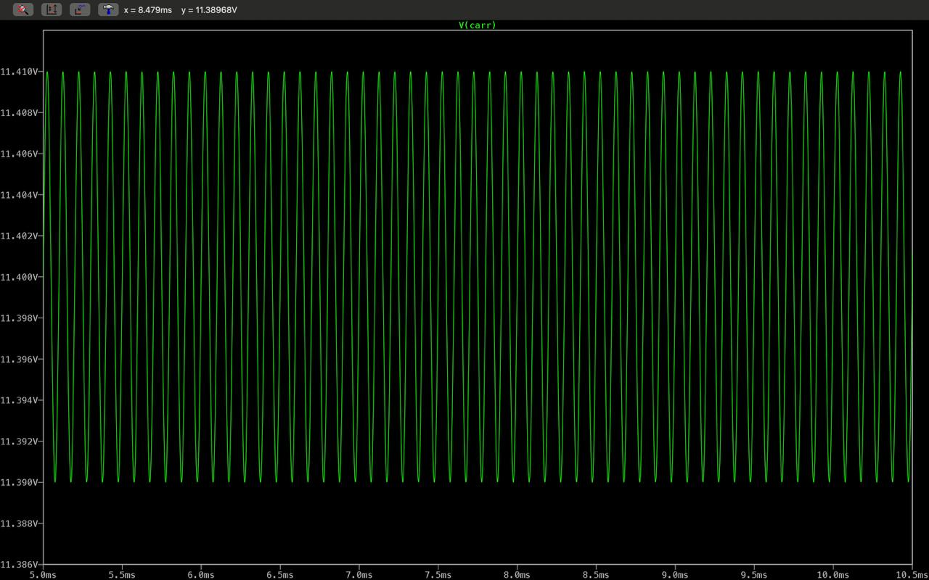
RESULT
Message Signal
Carrier Signal

Slide 10
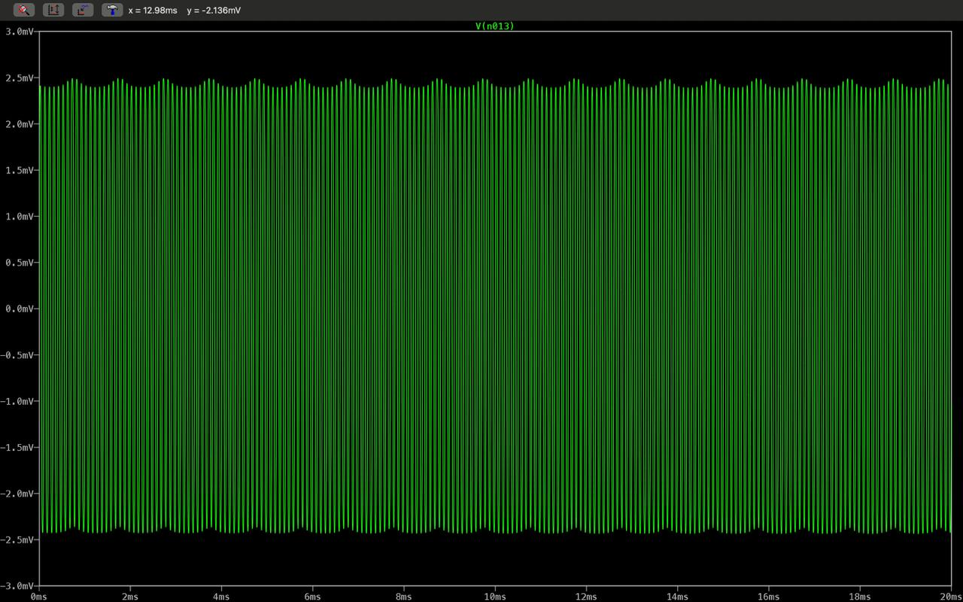
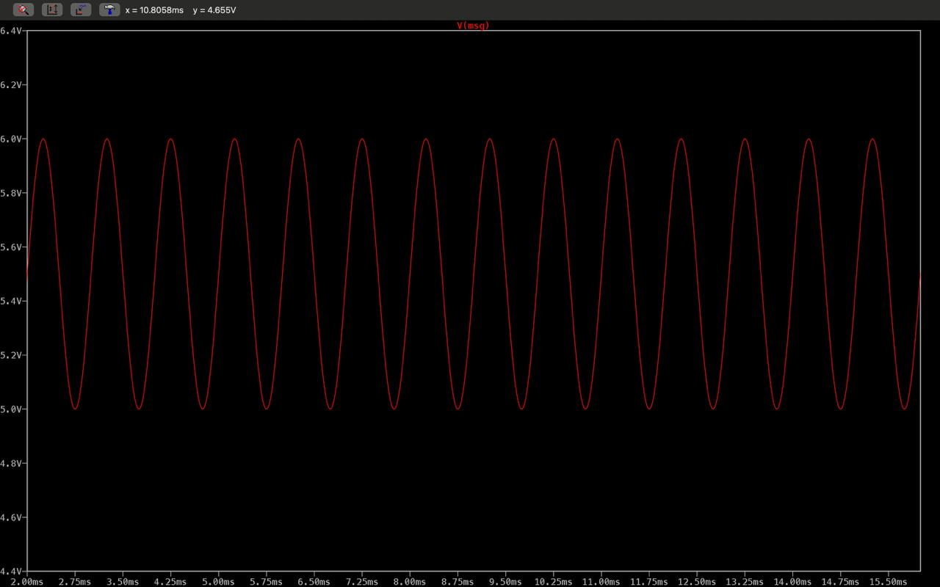
AM(Amplitude Modulated Signal
Demodulated Signal

Slide 11
Advantages Over Envelope Detector
Lower Distortion
The Envelope Detector(Diode network) works by nonlinear rectification/biasing, when two signals are applied unwanted terms are produced (DC offsets,harmonics,distortion etc.)
The distortion is minimized a lot when using a multiplier since it linearizes the transistor behaviour(using differential amps)
Signal Versatility
Product detector works with AM,DSB-SC(Double sideband suppressed carrier), and SSB signals.
Envelope detector only handles AM signals.
Superior Performance
More reliable signal recovery with better fidelity across various modulation schemes. Supports mixing(frequency translation)
Frequency range of operation is in the order of GHz for Gilbert cells which is much lesser for the basic modulators.

Slide 12



Real-World Applications
RF Systems & Mixers
Used in telecommunications for frequency mixing and phase-locked loops (PLLs) for stable frequency generation in radios and cellular systems.
True RMS Measurement
Enables accurate AC voltage measurement for any waveform shape, not just sine waves , in precis ion multimeters.
Power Measurement
Analog wattmeters multiply instantaneous voltage and current s ignals for accurate power readings .

Slide 13
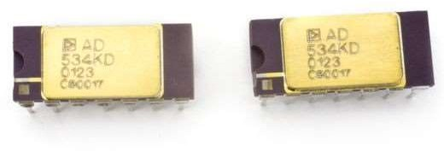
Ways To Improve
Four-Quadrant Translinear Multiplier
The AD534 IC employs a modified Gilbert cell that multiplies currents instead of voltages, offering wideband operation with fewer limitations than basic transconductance multipliers.
Enhanced Bandwidth
Operates across wider frequency ranges
Better Linearity
Improved accuracy in signal multiplication
AD534, Four-Quadrant Precision Multiplier, Analog
Devices, circa 1976 - CHM Revolution
Lower Noise
R educed interference and distortion

